Slide 1








Customer Influence Value UGCA, Fall 2018, 11/27
Dr. Anitesh Barua
David Bruton Jr. Centennial Chair Professor of Business
Distinguished Fellow, INFORMS Information Systems Society
Stevens Piper Foundation Professor
University of Texas Distinguished Teaching Professor
Associate Director, Center for Research in e-Commerce
McCombs School of Business, University of Texas at Austin
Email: aniteshb@gmail.com

Slide 2
The Network Value of a Customer
The distinction between customer lifetime value (CLV) and customer network lifetime value (CNLV)
Not a new concept
Celebrity endorsements
E.g., maybe very low CLV but possibly very high CIV
So what has changed and why?
Copyright Anitesh Barua 2018
Source: A. Azhar, www.peerindex.com

Slide 3
High CLV and CIV May Not Go Together
 | Low CIV | High CIV
High CLV | “Affluent” | “Champion”
Low CLV | “Irrelevant” | “Advocate”
Adapted from Kumar, Petersen & Leone

Slide 4
Customer Influence Value Example
Copyright Anitesh Barua 2017
Would not buy without influence
Would buy anyway with promotion
Average contribution margin = $100
Average acquisition cost = $25
Retention cost per year = $5
A customer influences one “red”
and one “green” user
$120
1 year
CLV=$70
$25
Value of influencing type “red” =
100 + 25 – 5 = $120
Value of influencing type “green” = $25 (saving the acquisition cost)
1-year CIV (without discounting)
= $145
How can we tell the type?

Slide 5
Identifying the “Red” & “Green” Types
Use data on
Demographics & transactions
Acquisition success/failure in the past
To develop red & green classification model
New customer acquired through influence/word-of-mouth
Classify as type red or green
Calculate the value of your influencers
Copyright Anitesh Barua 2018

Slide 6


Where is the Return on Influence (ROI)?
Can social or digital Word-of-Mouth (WOM) ROA be higher than that of paid search?
What kind of incentives are required for spreading the word in social networks?
How can we measure social ROA?
Copyright Anitesh Barua 2018

Slide 7
Direct Vs. WOM Traffic
Rank by Direct Traffic | Site | Direct Referrals
1 | CAMPAIGN SITE | 14,467
2 | ad.adlegend.com (AD SERVER) | 12,850
3 | g.doubleclick.net (AD SERVER) | 8,611
4 | www.jeuxvideo.com | 7,844
5 | www.youtube.com | 5,412
6 | FAN SITE | 4,455
7 | forums.gametrailers.com | 3,678
8 | es.wikipedia.org | 3,630
9 | FAN SITE | 3,494
10 | www.pornbb.org | 2,251
11 | www.meristation.com | 2,247
12 | answers.yahoo.com | 2,064
13 | mail.live.com | 1,985
14 | www.giga.de | 1,906
15 | COMPANY SITE | 1,650
16 | www2.hshare.net | 1,531
17 | www.spaziogames.it | 1,481
18 | www.akiba-online.com | 1,477
19 | www.joystiq.com | 1,097
20 | www.neogaf.com | 1,045
21 | FAN SITE | 1,026
22 | www.xbox360achievements.org | 725
23 | CAMPAIGN SITE | 291
24 | es.youtube.com | 72
25 | www.jeuxactu.com | 61
The common view of traffic sources

Slide 8
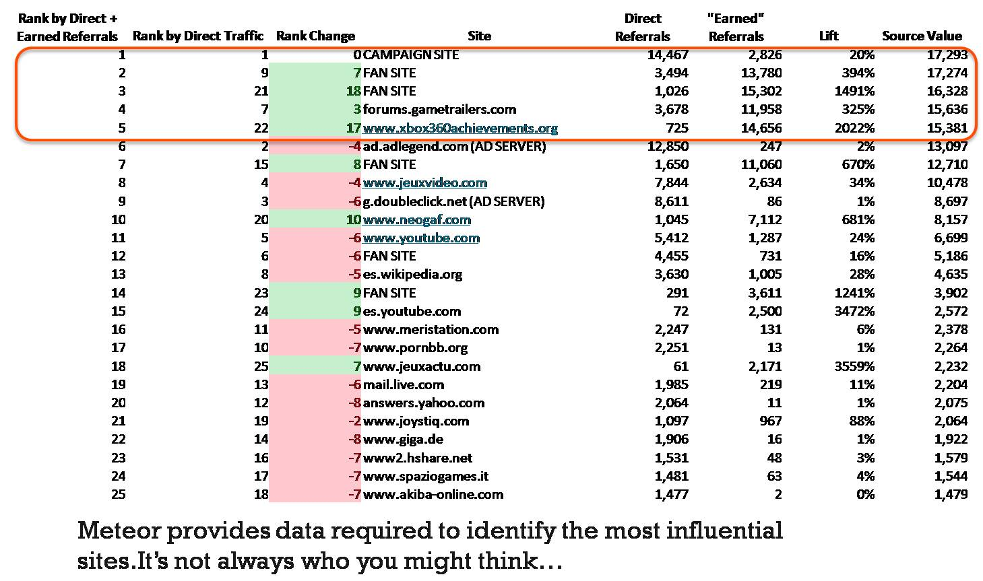
WOM (Social) Referrals
Rank
Direct + WOM traffic
Rank
Direct traffic
SITE
Direct traffic
WOM traffic
LIFT: WOM/Direct

Slide 9
“If You Got the Money Honey I Got the Time”
 |  | Marketing Tactic
Traffic | Metric | Paid search | Organic search | Display ads | Email | Total
Direct | Total cost | $9,342 | $3,000 | $10,428 | $2,000 | $24,770
 | Customer value | $50 | $50 | $50 | $50 | $50
 | Direct visits | 12,039 | 23,637 | 9,472 | 1,294 | 34,532
 | Conversions | 473 | 1,064 | 313 | 83 | 1933
 | Conversion rate | 0.039 | 0.045 | 0.033 | 0.064 | 0.056
 | Direct profit | $14,308 | $50,200 | $5,222 | $2,150 | $71,880
WOM | WOM Visits | 1960 | 7879 | 937 | 609 | 11385
 | Conversions | 136 | 697 | 93 | 110 | 1036
 | Conversion rate | 0.069 | 0.088 | 0.099 | 0.181 | 0.091
 | WOM profit | $6,800 | $34,850 | $4,650 | $5,500 | $51,800
 | Profit lift = WOM $ / Direct $ | 0.4752586 | 0.694223108 | 0.89046 | 2.5581 | 0.72065

